Slide 1
Topic 3 – Exploratory Data Analysis
Statistics and Data Analysis
COR1-GB.1305
Prof: Chris Volinsky
NYU Stern: Fall 2023

Slide 2
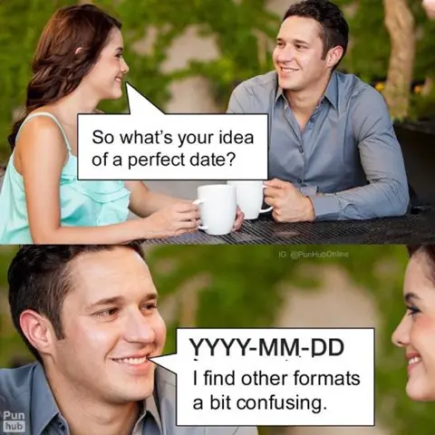

Slide 3
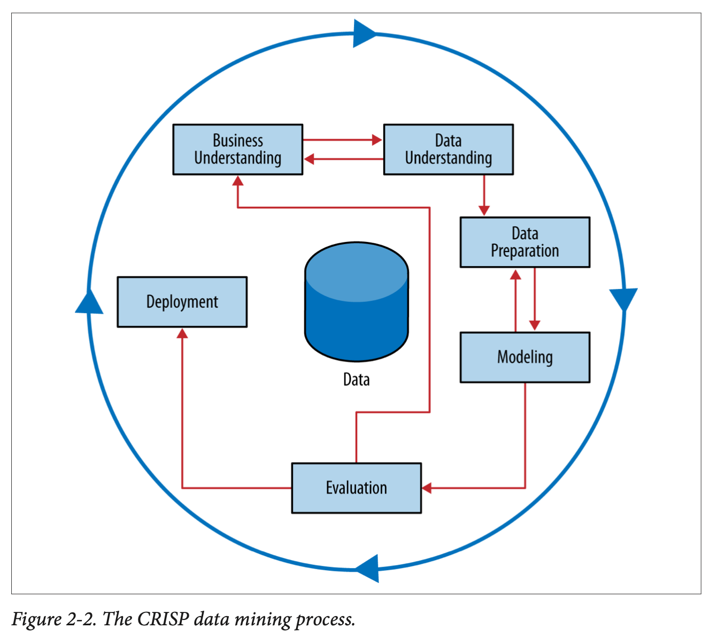
Understanding Your Data
Understanding your data goes hand and hand with the business problem you are trying to solve

Slide 4
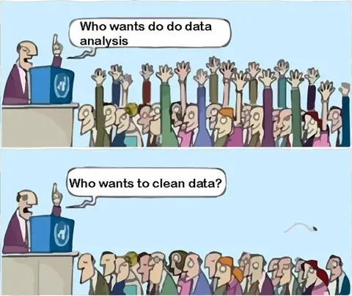
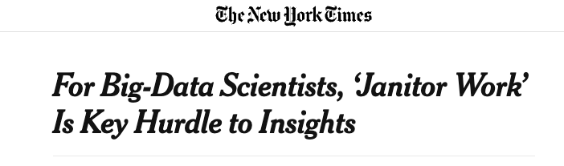
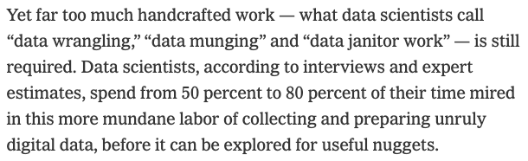
Reality
Steve Lohr NYT 8/17/2014

Slide 5

Managing Data
Module1_Data:
Managing_data.ipynb
Command_line.ipynb

Slide 6
Where to Find Data
In business critical systems
Challenge: these systems are often not set up for collection of data, they are for running a business
On line
Challenge: Companies often do not give access to critical data, and if they do it is via a rate limited API
Can use parsers, scrapers, and other tools
Useful modules like “Beautiful Soup” can scrape web sites
GenAI is changing this scene rapidly…
Curated data science websites
Challenges: Sanitized, much analyzed data
UCI repository
Lots of data science courses!
Notes:
Talk here about finding data for their projects….dont try and take the easy road.

Slide 7
Extracting Data from Websites
Module1_Data:
API.ipynb

Slide 8
Exploring data
Important to take time to explore every attribute of your data
Exploratory Data analysis – prior to any modelling
Summaries
Outliers
Missing Data
Correlations

Slide 9
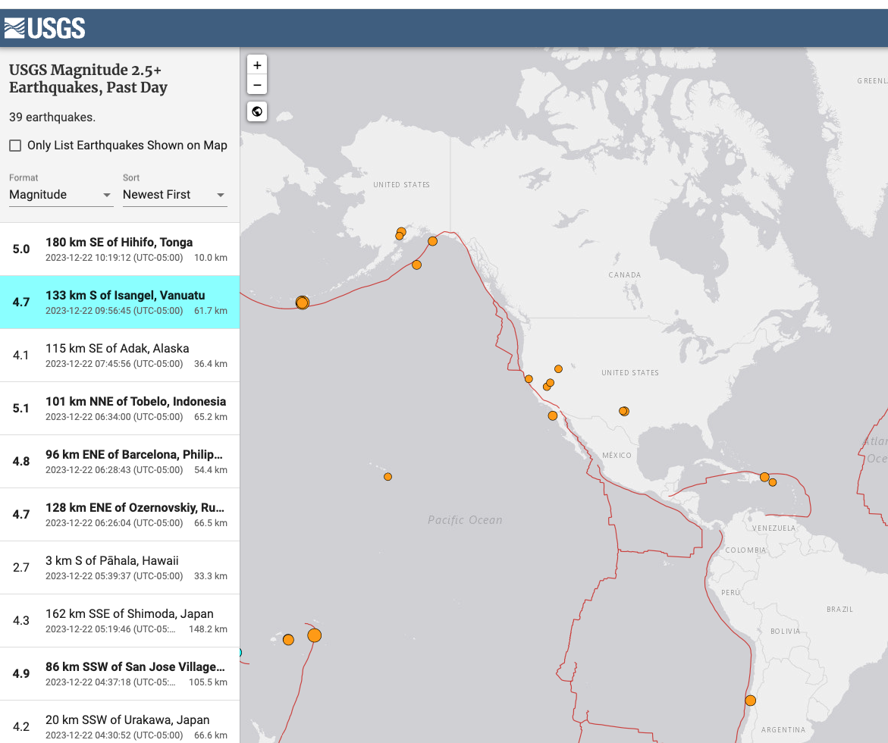
Types of Data
Structured
Unstructured
Time Series
Text
Image
Media (Audio/Video)
Spatiotemporal
Network-based
All of the above?

Slide 10
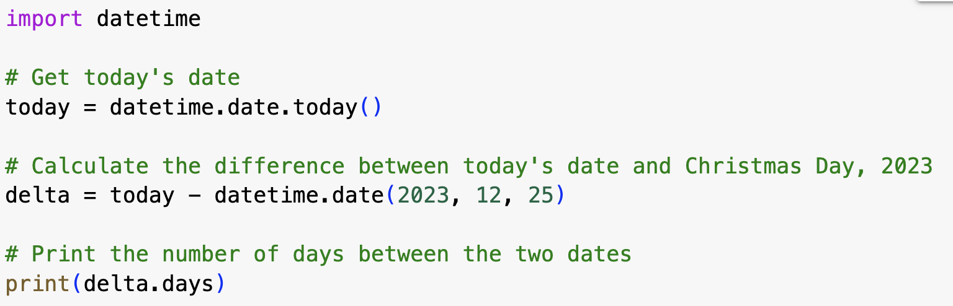
Feature Types
Numeric: anything where calculations are meaningful
Numbers (that mean numbers)
Dates (that look like numbers …)
Categorical/Nominal: cannot do meaningful calculations
Multi-valued
Might have numeric labels!
Ordinal – where categories are ordered
Ordinal: Income (A: 0-50k; B: 50k-100k; C: 100k-500k; D: > 500k)
Nominal: EyeColor (A:Blue; B=Brown; C=Green; D=Other)
Binary (special case of categorical):
Two possible values, in particular 0/1
Datestamps
Beware of format!
Use import datetime for date calculations
Notes:
May need to create variables
e.g., average balance may not be in any database, but would have to be computed during the data prep stage.

Slide 11
Things can get messy
How About
Names
Social Security numbers
Credit ratings
Zip codes
Text
Images, sound
SIC industry codes
You need to make sure that your software recognizes the right data type
Make numbers look like numbers
Make categorical NOT look like numbers

Slide 12
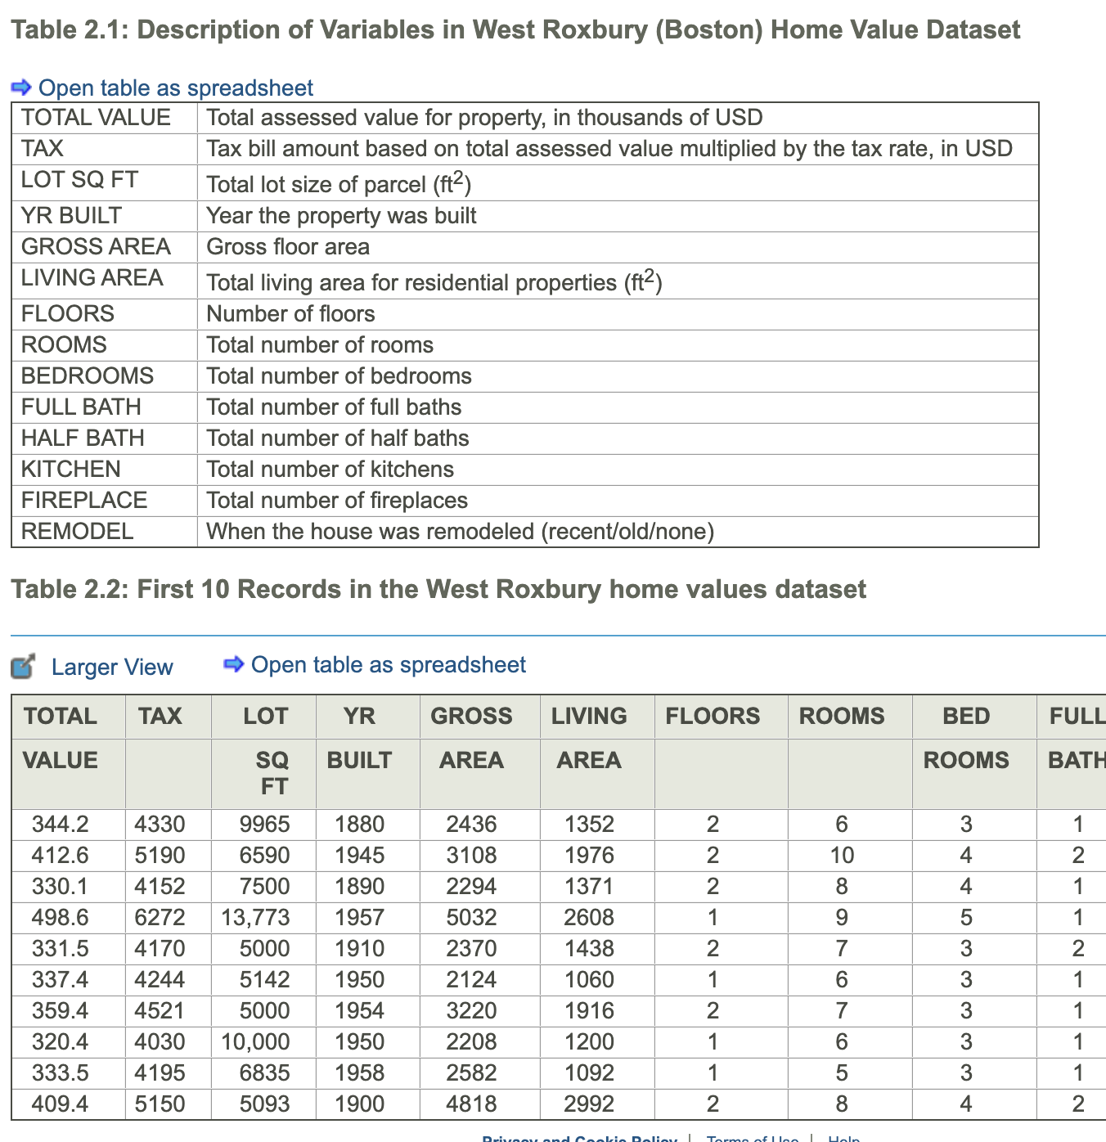
Exploring data in python
Example: Home prices in Boston
Looking at data in Python:
Ideally data can be input as a .csv file
Make sure no commas!
Use tools for initial manipulation of data
Renaming variables (.rename)
Viewing slices of data (.loc and .iloc)
Summaries of variables (.info and .describe)
Categorical variables (.value_counts)
Exploring data (.head, .tail)
Merging and splitting attributes (.concat, .split, other text tools)
Can use sampling if data is too large (.sample)
Play around with it!
Shmueli Ch2.4

Slide 13
Categorical Variables
Lets say we wanted to study impact of diet type on Cholesterol
Name | Diet | Cholesterol
Alberto | Vegetarian | 135
Becky | Vegan | 112
Callie | Omnivore | 198
Daneyah | Pesca | 201
Erica | Omnivore | 155
… | … | …
Four types:
Vegan (Vn)
Vegetarian (Vg)
Pescatarian (P)
Omnivore (O)
For some methods (like regression) you need to re-code this variable as binary (0,1) indicator variables (also called dummy variables)
For a categorical variable with k levels, you should create k-1 indicators
pandas.get_dummies (drop_first=TRUE) sklearn.preprocessing.OneHotEncoder

Slide 14
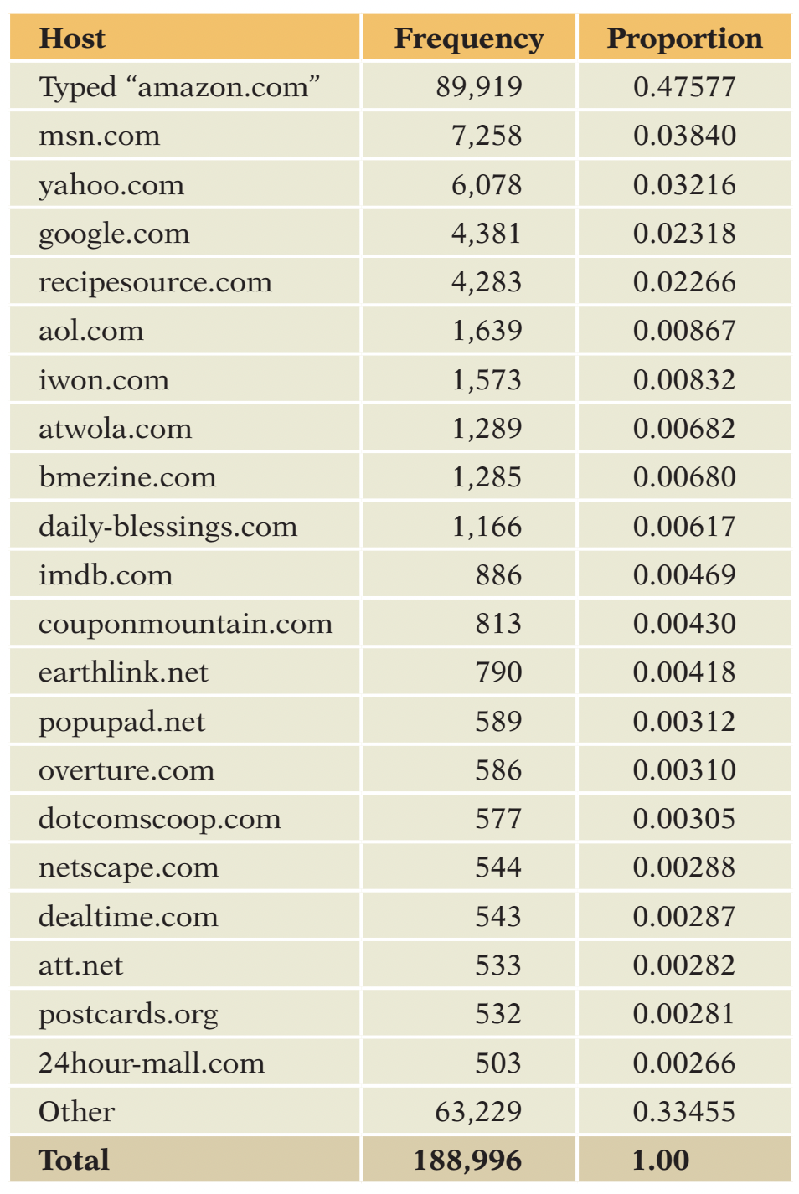
Categorical Variables
Another issue with categorical variables: there can be too many levels
May want to transform to top levels + “other”
What is most relevant to the business context of the analysis?

Slide 15
Outliers
Outliers are observations that are far from the mean, and fall outside the range of most of the data
Can be found via visualization or simple sorting
Outliers typically are attributable to one of the following causes
The measurement is observed, recorded, or entered into the computer incorrectly.
The measurement comes from a different population.
The measurement is correct but represents a rare (chance) event.
Outliers should always be considered and inspected to see if they are “real” or some artifact of data collection

Slide 16
Missing Data
Missing Data: Data points that are not recorded or are absent in the dataset.
Can be represented by “.” “NA” “99” “-1” etc.
Python uses “NaN”
Reasons for missing data
data entry errors,
non-responses in surveys
system errors, etc.
Why Identifying Missing Values is Crucial
Data Integrity: Missing values can lead to biased or invalid results, affecting business decisions.
Quality Analysis: Ensures the quality and accuracy of the dataset, crucial for reliable analytics.
Model Performance: Some machine learning algorithms do not work well with missing data, affecting predictive accuracy.
Pandas functions:
isnull(), notnull(): To detect missing values.

Slide 17
Strategies for Missing Data
Deletion Methods:
Listwise Deletion: Remove entire rows where any value is missing.
Pairwise Deletion: Use available data, ignoring cases where data is missing.
Imputation Methods:
Mean/Median/Mode Imputation:
Replace missing values with mean, median, or mode of the column.
Predictive Modeling:
Use algorithms like regression or k-nearest neighbors to predict and fill missing values.
Multiple Imputation:
A more advanced technique that imputes values multiple times to account for the uncertainty of missing data.
Pandas functions
dropna(): To drop rows or columns with missing values.
fillna(): To fill missing values with a specific value or method (mean, median, etc.)
SciKitLearn:
SimpleImputer: Basic imputation strategies
IterativeImputer: Modelling based imputation

Slide 18
Data Visualization

Slide 19
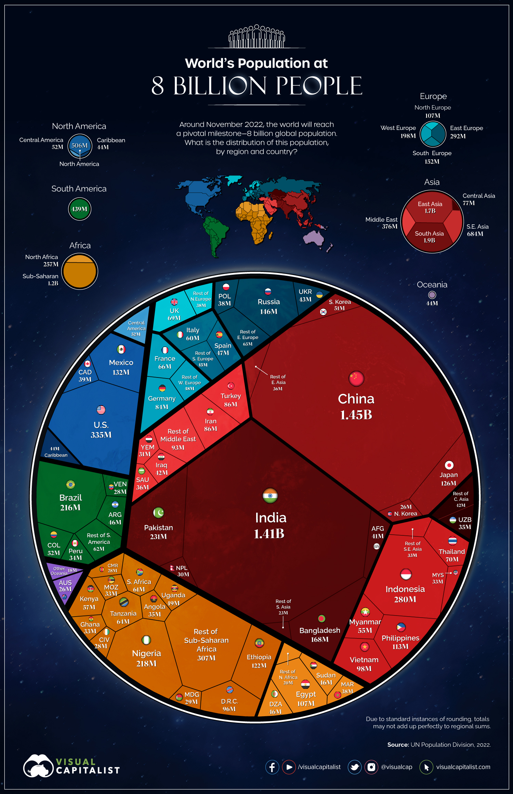
Data Visualization Types
Infographics
Infographics use clever layouts and tools to portray data in a way that is appealing to a casual viewer
Enhanced by well designed graphic design elements
https://www.visualcapitalist.com/visualized-the-worlds-population-at-8-billion/#google_vignette

Slide 20
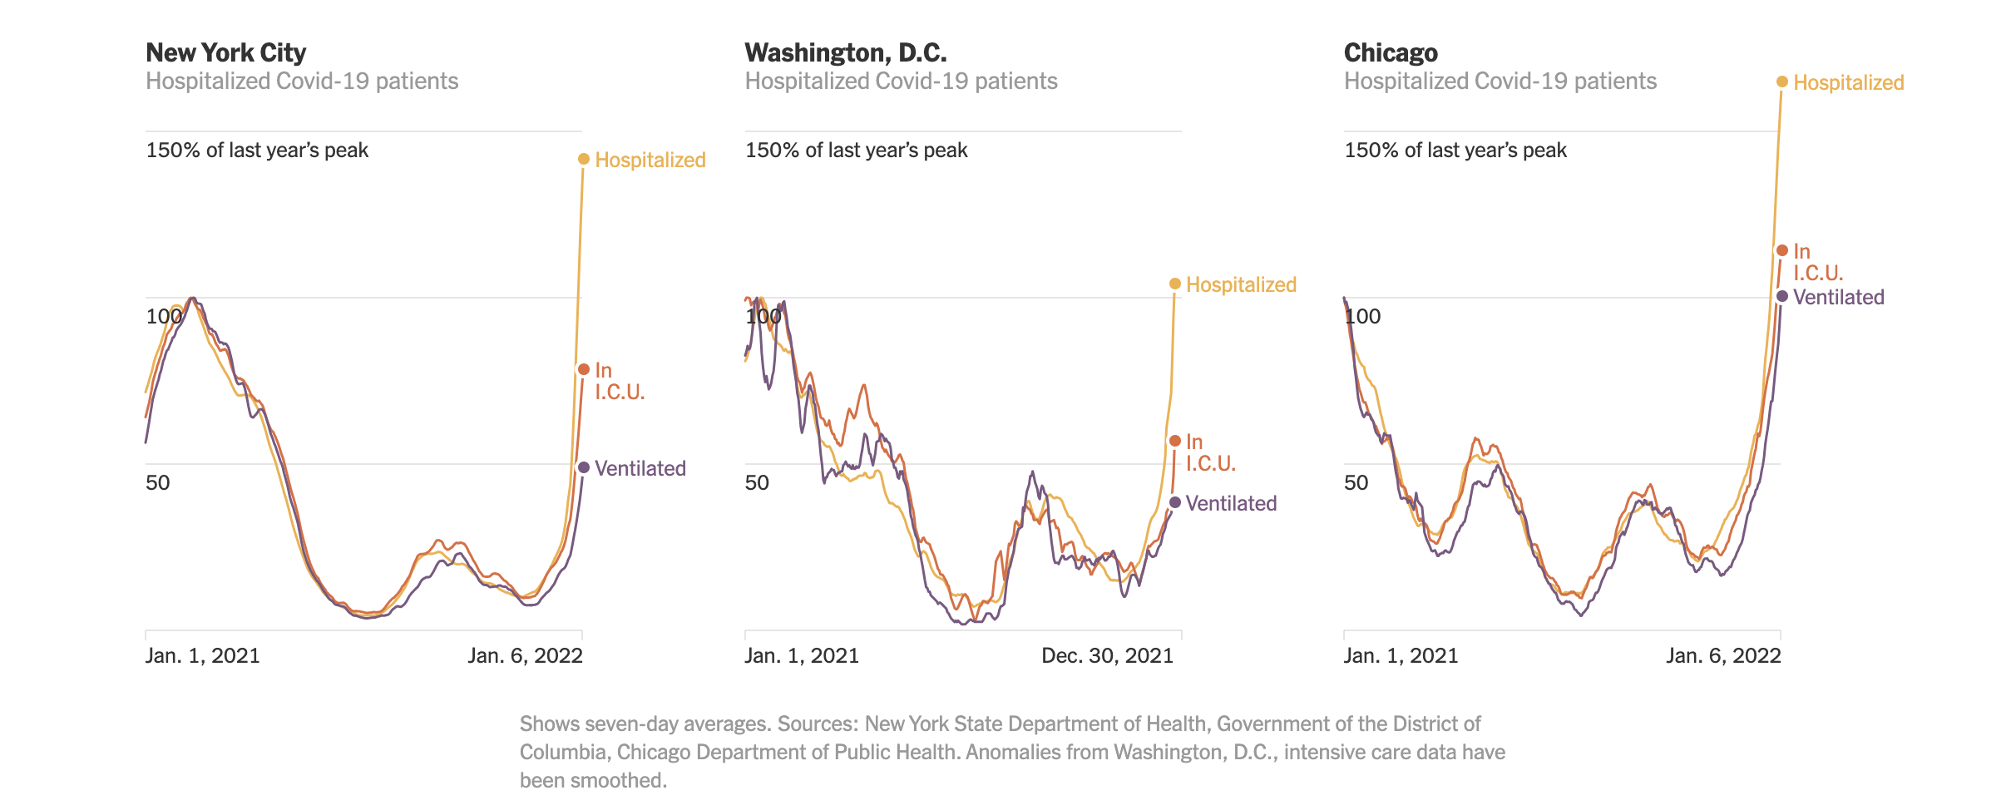
Data Visualization types
Scientific: Scientific visualizations use tools familiar to statisticians (barcharts, boxplots, etc) to demonstrate complex relationships between attributes, and are often interactive.
https://www.nytimes.com/interactive/2022/01/09/us/omicron-cities-cases-hospitals.html

Slide 21
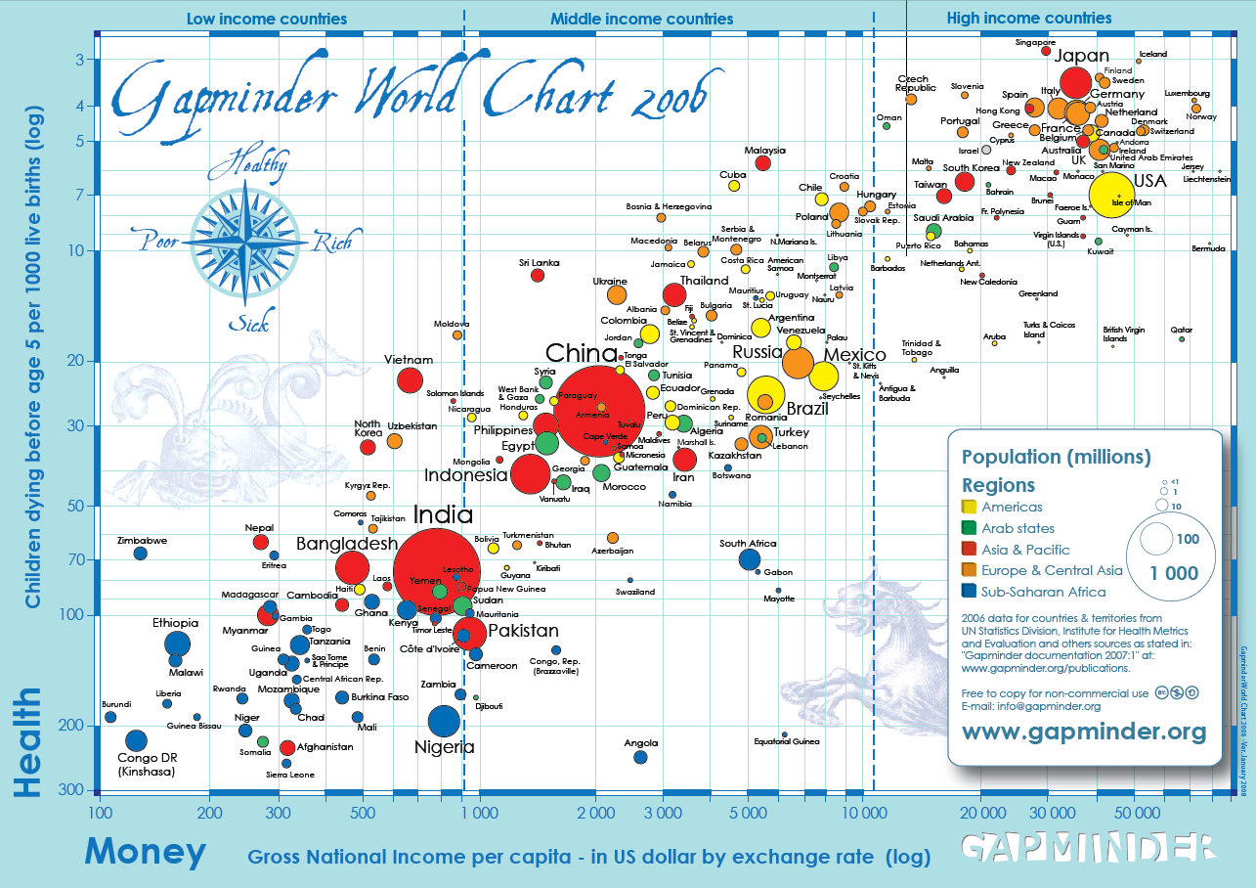

Data Viz: Good examples
The best data visualization talk you will ever see:
Hans Rosling
https://www.youtube.com/watch?v=usdJgEwMinM

Slide 22
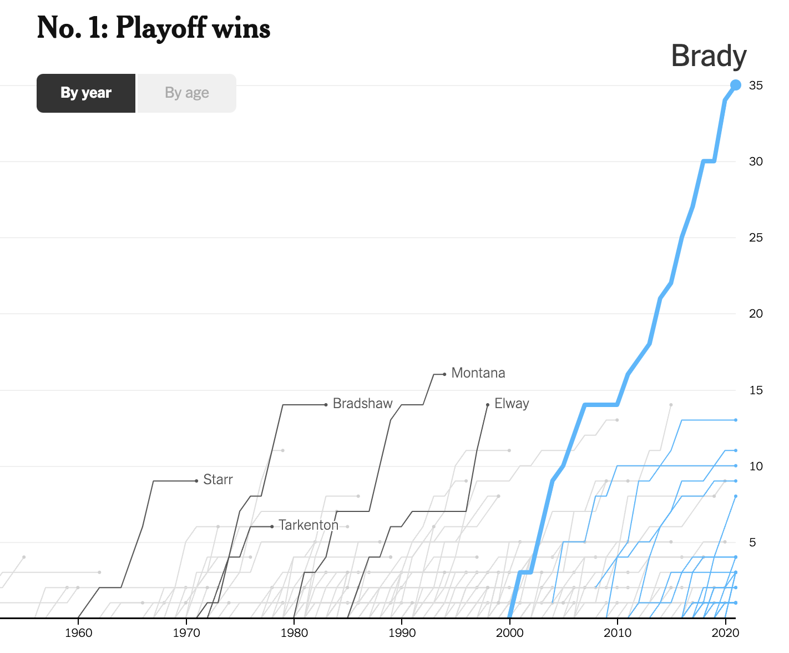
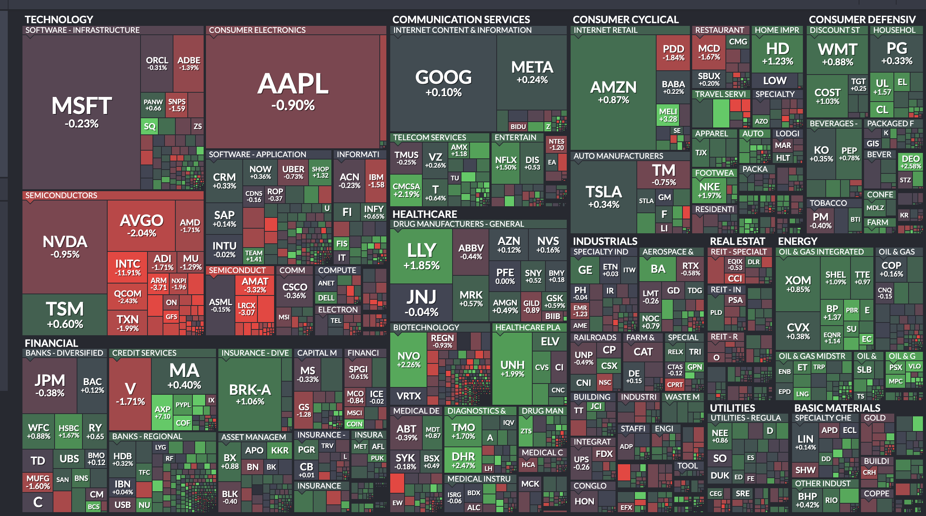
Stock Market Map
finviz.com
(treemap)
NYTimes.com
Year In Graphics 2023

Slide 23
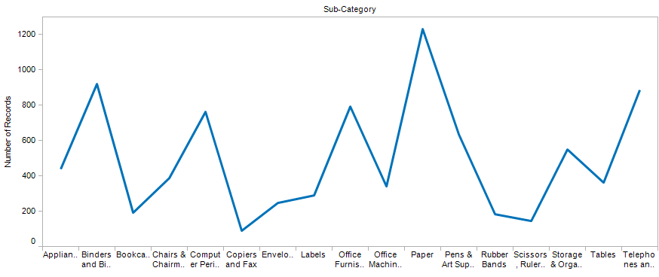
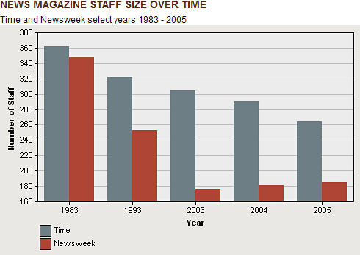
Data Viz: Bad Examples

Slide 24
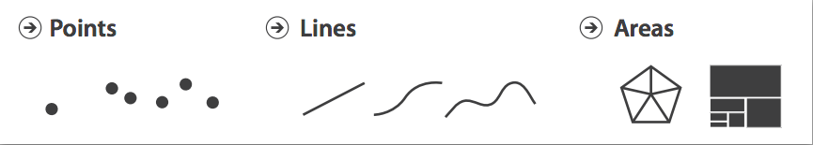
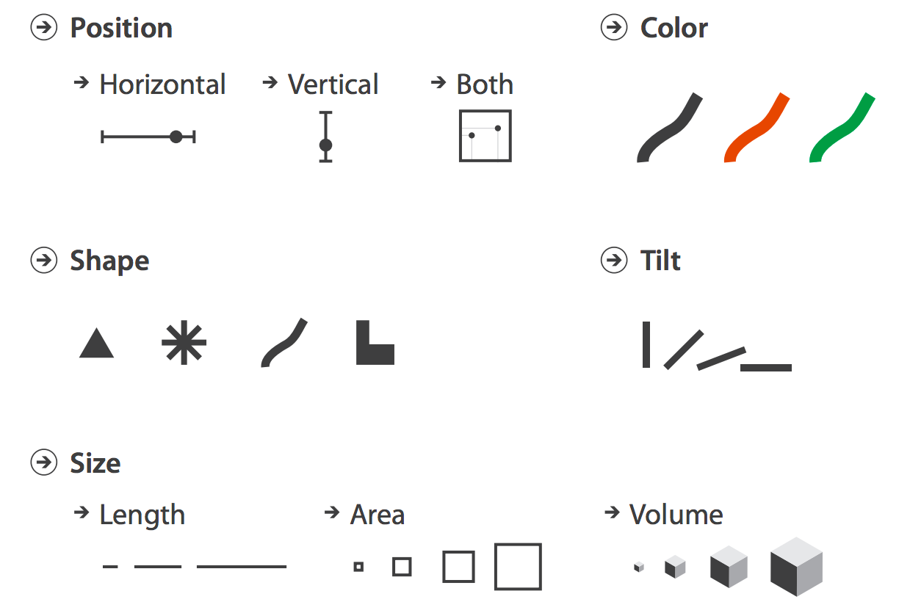
Data Visualization
Data Visualization is a challenging topic – very hard to do well
Many design decisions to make
INFO-GB 3306.10
Data Visualization theory covers things like
What do humans perceive well
How to use marks, color, etc.
Basic components of data visualization can be used as part of the EDA process
Histograms
Boxplots
Scatterplots

Slide 25
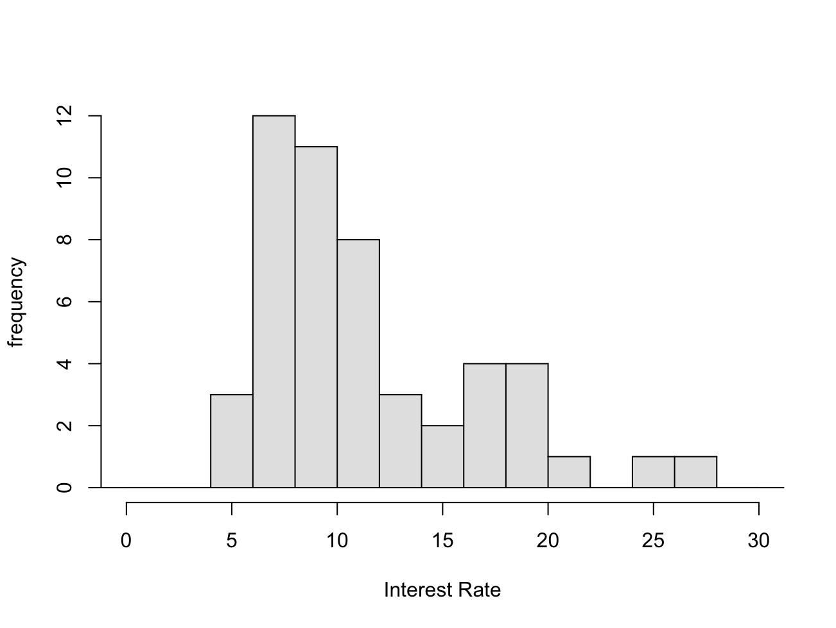
Visualizing Numeric Data: Histograms
Probably most used (and useful) way to present numeric data
Histograms provide a view of the data density. Higher bars represent where the data are relatively more common.
Histograms are especially convenient for describing the shape of the data distribution.
What do you learn from this?
https://www.openintro.org/data/index.php?data=loan50

Slide 26
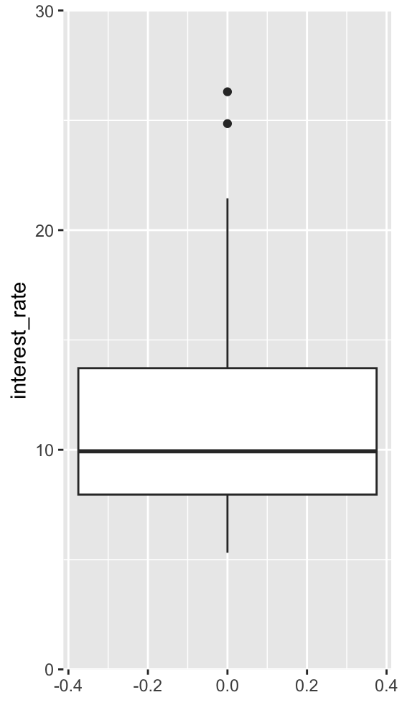
Boxplots
A Boxplot is another way of getting a quick visual clue of the key points of the data distribution:
Suspected Outliers
Upper range
75th percentile
median
25th percentile
Lower range

Slide 27
Boxplots
Outliers are called out in boxplots for further evaluation
Suspected Outliers
1.5 x Interquartile Range (IQR*)
IQR=75th%ile - 25th%ile
Any point further than 1.5 x IQR away from the box is labelled a potential outlier
Warning: software may differ on this definition

Slide 28
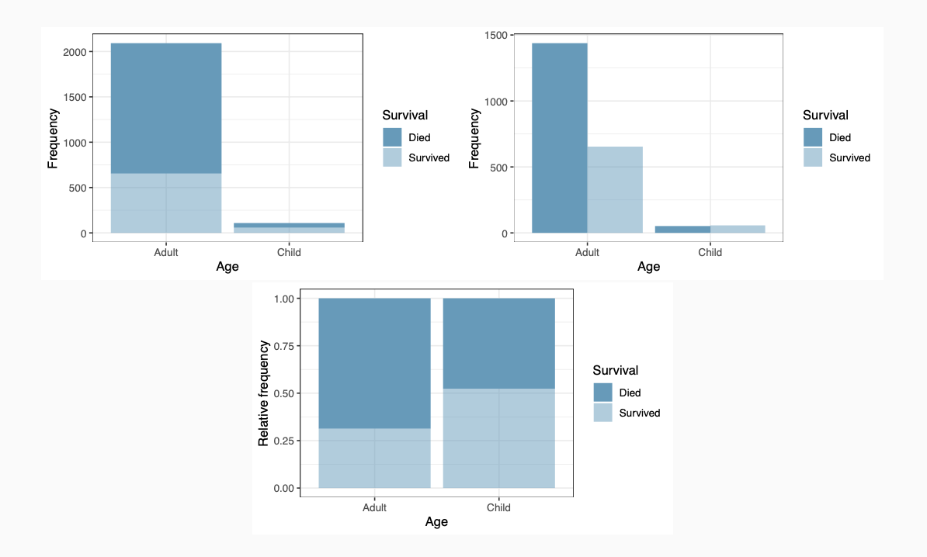
Multiple Variables: Categorical
Three different ways of presenting contingency tables
Stacked bar
Side-by-side bar
Standardized bar

Slide 29
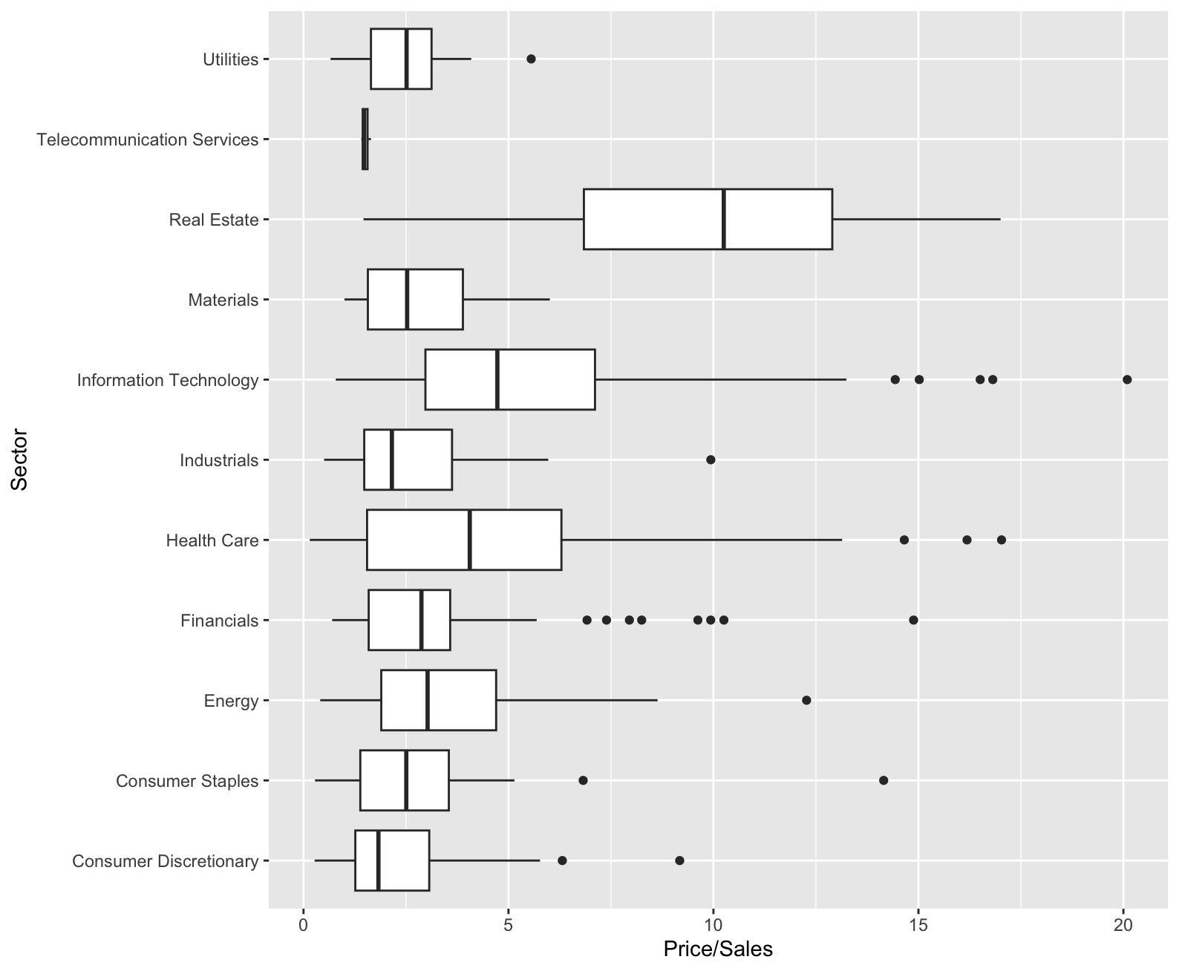
Mulitple Variables: Categorical and Numeric
Side by side boxplots allow you to compare numeric distributions across variables which are categorical
S&P 500 data
Price/Sales ratio
by Sector

Slide 30
Multiple Numeric Variables- Scatterplot
Scatterplot is the standard tool to display relation between 2 variables
e.g. y-axis = response, x-axis = suspected indicator
useful to answer:
x,y related?
Linear correlation
quadratic
Other
Strange patterns?
outliers present?

Slide 31
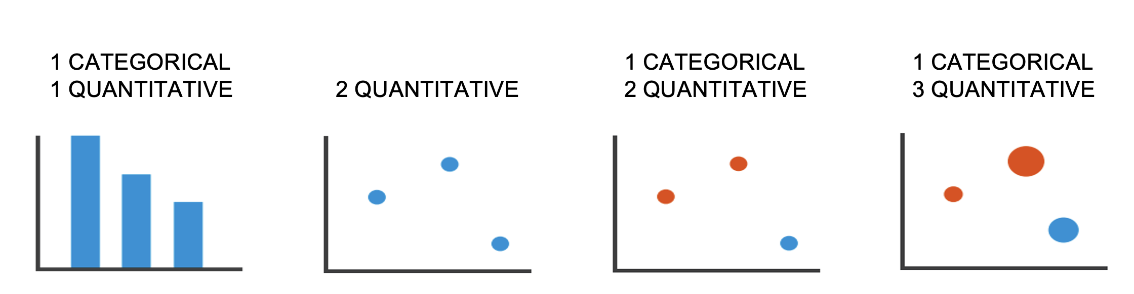
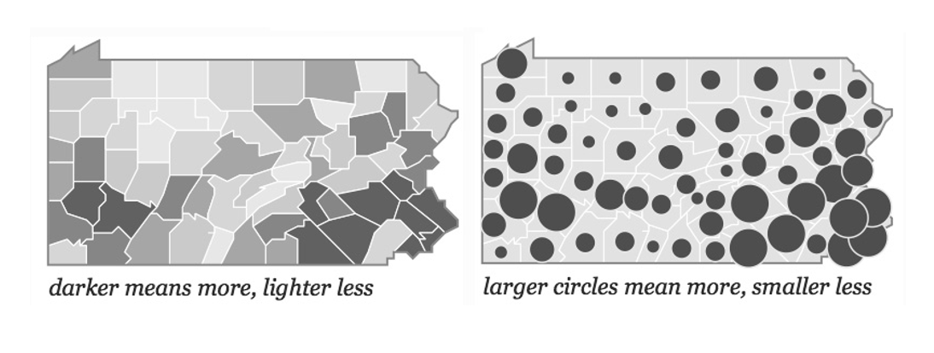
Best Practices?
Different ways to do the same thing

Slide 32
Python Visualizations
Module1_Data:
Visualizations.ipynb

